Slide 1


Simplified Onboarding Methods
October 2023
Technology Assessment
by
Aryan Chaudhary
Sadhana Srinivasan
Stuti Ananta
Vibha V. K.

Slide 2
Amazon Robotics should implement Extended Reality (XR) solutions for initial training, combined with a Large Language Model (LLM)-based chatbot for on-the-job assistance

Slide 3
01
Problem Statement
02
Situation
03
Evaluation Criteria
Agenda
04
Technology Overview
05
Evaluation Matrix
06
Recommendation
07
Next Steps

Slide 4
Problem Statement

Slide 5
Amazon Robotics is searching for effective solutions to onboard new associates and operation managers
Problem Statement

Slide 6
Current Situation

Slide 7

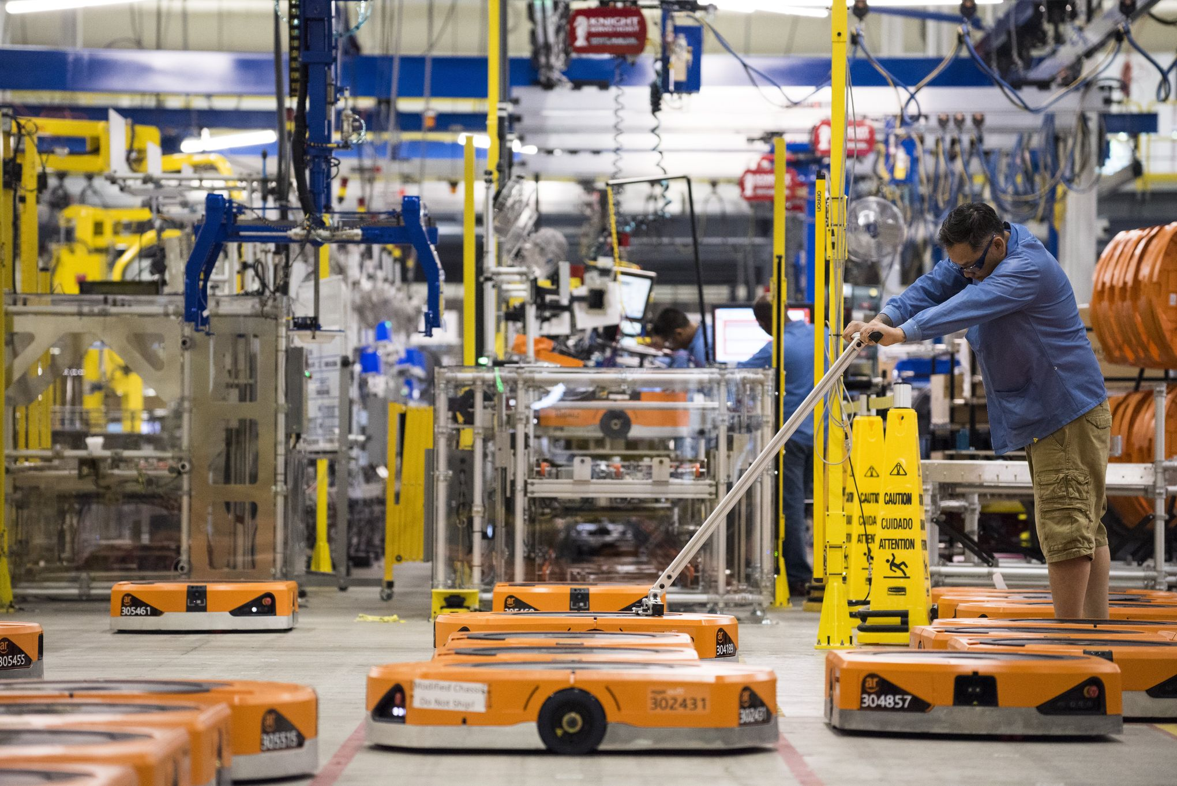
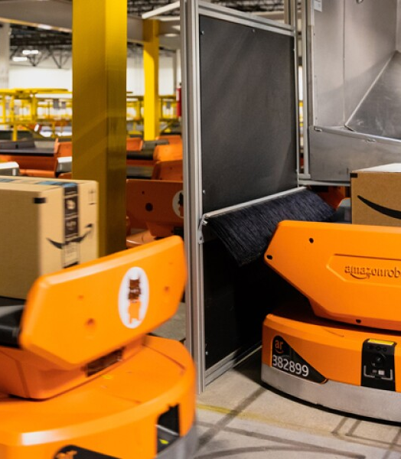
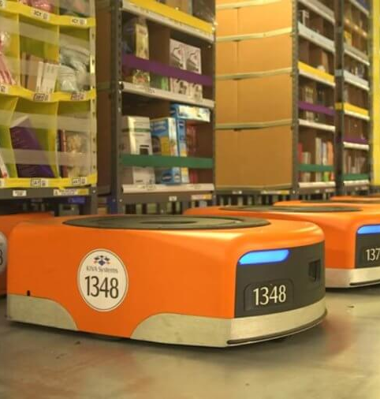
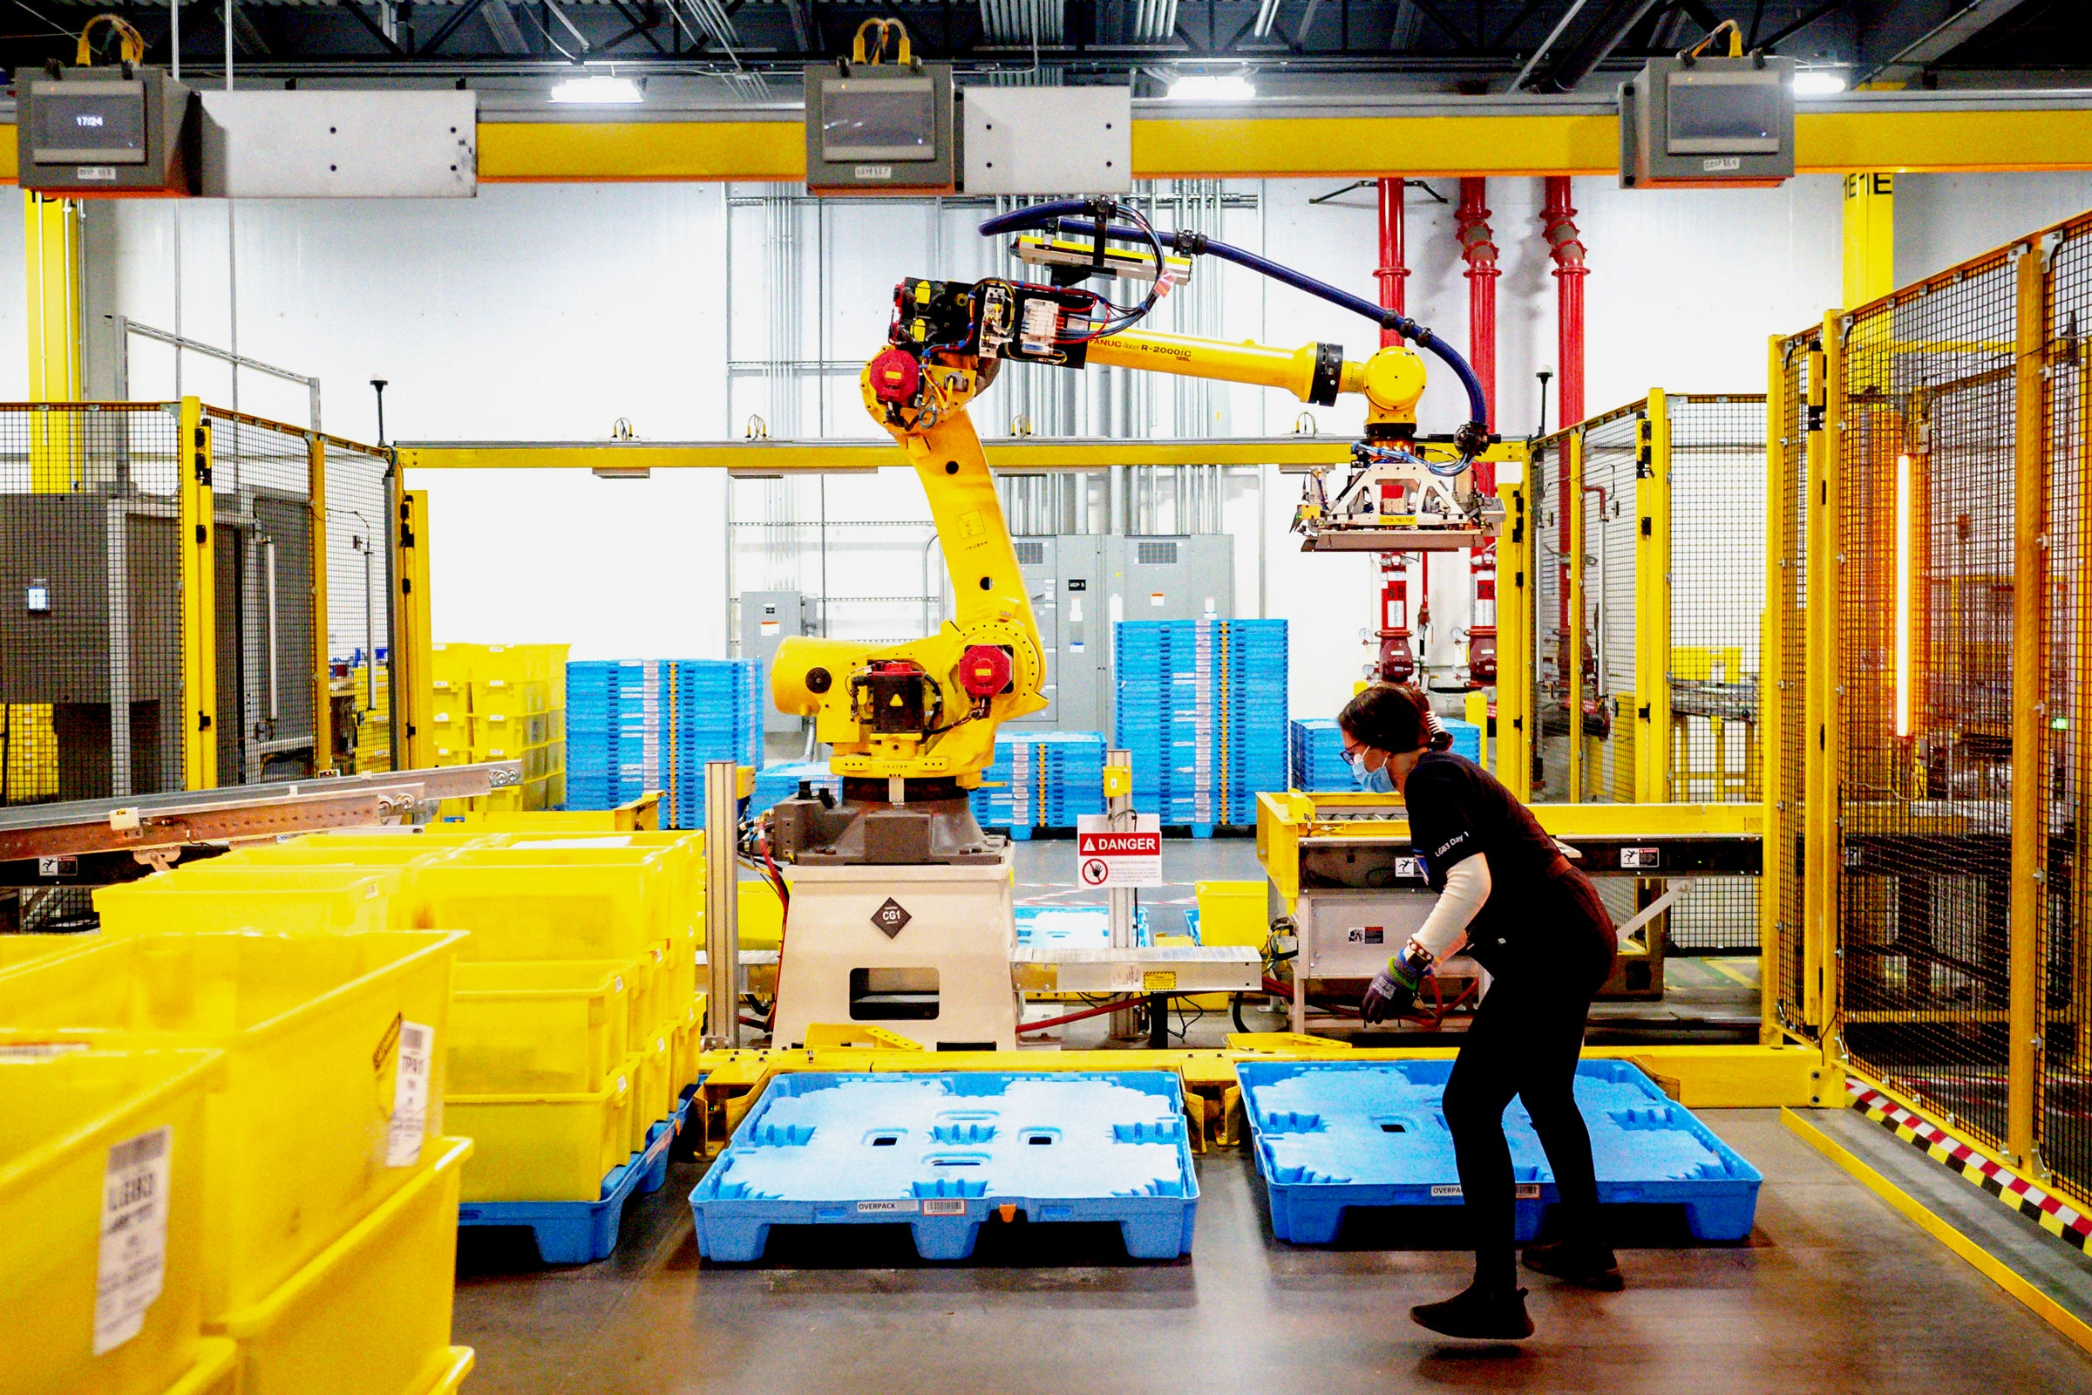
New hires are trained for their job roles through extended hours of audio-visual and textual pieces of training
Types of employees in scope
Associates
Operation Managers
Docs/PPTs
Interactive Webpages/ Movies
On-the-job training
Situation

Slide 8

New hires spend an extended amount of time in training but retain little information
In-Training Pain Points
Escalation resolution post-training requires high human intervention
Operation Managers take months/years to operate at their best
High churn rates (50% for associates, 25% for associates) for employees make the issue more prominent
Employee Onboarded
3 days spent in training associates
~18 hours of text and video based training
~$900 per associate spent (Opportunity Cost)
Information overload with low retention rates
Post- Training Pain Points
Situation

Slide 9
7 Evaluation criterion were identified and segmented into 3 phases
Phase 1
Phase 2
Phase 3
0/1
Information
Retention
25%
TBD
Data Security
CapEx
Learning
Efficiency
25%
TBD
OpEx
Scalability
25%
Multimodal Integration
25%
-> Scope for Interim
Evaluation Criteria
Notes:
Learning Efficiency (Reduction in training time)
Performance Capabilities (Ability to use existing information )

Slide 10
Technology Overview

Slide 11
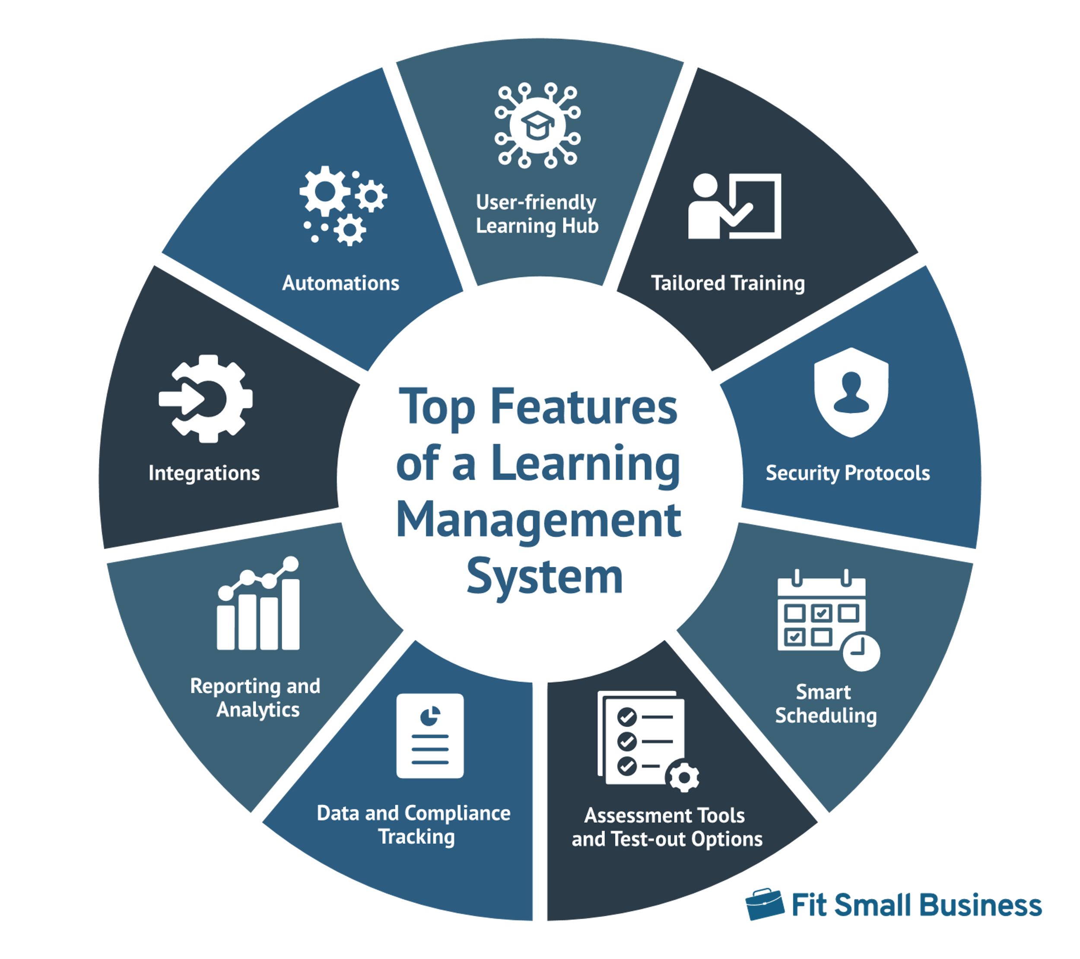
Learning Management System (LMS) offer personalized training to new hires
Software application that provides a standardized framework
Can be hosted on-premise or in the cloud
Can be proprietary or open-source
Helps manage, deliver, and track educational courses or training programs
Technology Overview
Notes:
A Learning Management System (LMS) is a software application that provides a framework for managing, delivering, and tracking educational courses or training programs.
It is used by educational institutions, corporations, and other organizations to facilitate online learning and training.
An LMS allows instructors and administrators to create, distribute, and manage learning content, as well as to monitor and assess the progress of learners.
LMS platforms can be hosted on-premises (on the organization's own servers) or in the cloud (on the servers of the LMS provider).
They can be proprietary (commercially available) or open-source (freely available and modifiable).
The choice of an LMS will depend on the organization's specific needs, budget, and technical capabilities.

Slide 12






LMS offers easy integration with existing systems enhancing the overall learning experience
Data Security
Multimodal Integration
Security measures in place to safeguard security and privacy of data
Offers easy integration of diverse types of content and with different platforms
Information Retention
LMS Platforms
Employs gamification to keep users motivated and supports self-paced learning by leveraging AI
Scalability
Need to be anticipative of the scale; Differs across deployment types
Learning Efficiency
Cost
Offers a streamlined L&D experience via a user-friendly interface thereby, reducing learning time
LMS price, hosting, setup fee, customization, tech support
Technology Overview
Notes:
Cloud-based solutions typically have lower upfront costs but may have higher ongoing subscription fees. On-premises solutions may have higher upfront costs but may be more cost-effective in the long term, especially for larger organizations.

Slide 13







LMS platform attributes are heavily dependent on the mode of deployment
Key Players
Pros
Cons
Customization
Data security
No monthly subscription fee
High initial expense
In-house maintenance
Limited scalability
On-Premise
Low upfront cost
Provision to scale
Ease of implementation & maintenance
Lack of data control​
Limited customization​
Cloud-Based
Technology Overview

Slide 14

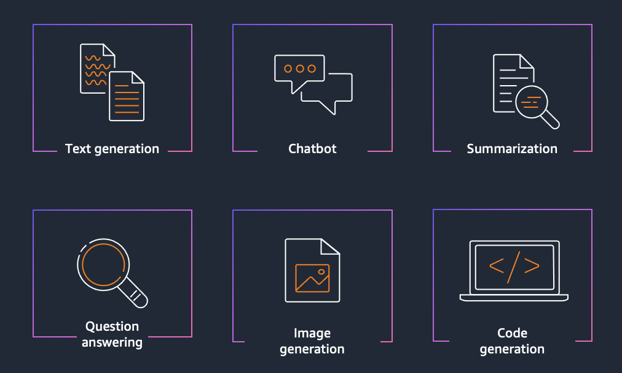
LLM chatbots are ideal for answering problem-specific questions
Large Language Models (LLMs): AI models trained to learn from large volumes of data
Designed for processing and generating natural language
Mimics human-like conversations
Provides customized answers to questions
Available 24/7
Technology Overview

Slide 15
LLM chatbots are secure and easy to scale but are expensive and high cost of deployment
Data Security
Multimodal Integration
Data used for training LLMs is only accessible to the customer
Can leverage existing training material but limited to specific models
Information Retention
LLM
Chatbots
Scalability
Improves retention but increases dependency on the technology
Can be customized and scaled for Amazon's employees
Learning Efficiency
Cost
Reduces learning time as employees are provided tailored and elaborate answers
Developer, fine-tuning costs, additional costs around $1.5 Million
Technology Overview
Notes:
Amazon said it would invest up to $4 billion in Anthropic
LLM chatbots are secure and easy to scale but have low retention rates high costs of deployment.

Slide 16









Four LLM solutions were considered for our use case
Amazon Bedrock
GPT-4
GPT 3.5 Turbo
Bard AI
+
Can be fine-tuned to fit use case
Not cloud dependent
Can only process text-based documents
Can provide audio response
Can't sustain complex and multi-turn conversations
Only offered on Google cloud
Can process multimodal information
API for fine-tuning not available yet
Can compute complex input data
Can compare performance of up to 3 pre-trained models
Offers fine-tuning to fit use case
Allows Retrieval Augmented
Generation (RAG)
Technology Overview
Notes:
Source images : Powerpoint Stock Images
Amazon bedrock: more of a platform than
Three llm solutions were considered for our use case but add a note saying there are more

Slide 17
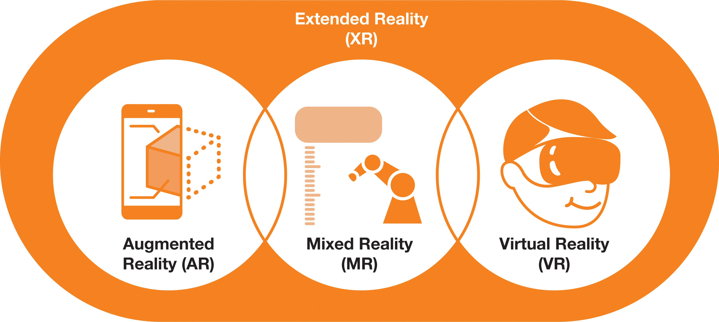

XR creates an immersive learning experience for new hires
Umbrella term for immersive technologies
Simulates interactive real-world scenarios
Trainees can practice job activities in real-time
Boosts employee engagement and attentiveness
Technology Overview
Notes:
AR augments visuals, audio onto the real world
VR simulates an interactive artificial 3D environment
MR allows superimposition and interaction between the digital and the real world
Trainees can practice job activities in real-time at their own pace
Allows new employees to practice these tasks without the risk of injury or endangerment
Boosts employee engagement and attentiveness
https://toolbox.igus.com/motion-plastics-blog/how-could-the-manufacturing-sector-utilize-extended-reality <div> Icons made by <a href="https://www.flaticon.com/authors/freepik" title="Freepik"> Freepik </a> from <a href="https://www.flaticon.com/" title="Flaticon">www.flaticon.com'</a></div>

Slide 18
XR technologies improve learner comprehension, decrease training time
Data Security
Multimodal Integration
Encryption, logical security can be incorporated
Need to build learning modules from scratch (takes 6 months)
Information Retention
AR and VR
Scalability
10-15% increase in knowledge retention
Scaling hardware is expensive, time-consuming but over-the-air updates aid XR software
Learning Efficiency
Cost
Can achieve 80% reduction in learning time
Headsets cost $150 - $1000 AR/VR High CapEx depending on use-case
( $350K+ - $300M )
Technology Overview
Notes:
https://www.strivr.com/customers/walmart/ https://industrytoday.com/scaling-ar-and-vr-solutions-to-transform-business/ ota 80%- 30 minutes to 5 minutes training module walmart for pickup towers
1.5 pwc attention study 86% forbes article: AR gives live instruction to help people use the equipment
https://www.atlantanewsfirst.com/2023/04/07/ups-invests-345m-vr-training-additional-safety-technology/ 345 million

Slide 19














XR is revolutionizing employee training across industries
VR Hardware
VR Platforms
AR Hardware
AR Software
Typically use HMDs (Head Mounted Displays)
Offers position tracking and gesture control
Simulates different use cases
Soft-skill training for managers
Driving
Handling equipment in manufacturing, e-commerce
Uses Marker-based or Markerless technology Can often be smartphones Supports voice and video-chat during device usage
Augments visuals for different use cases
Medical and food packaging
Wiring installation
Machine maintenance
Technology Overview
Notes:
. To protect the environment, every BASF employee in production must complete compulsory annual exercises in accordance with the German Water Resources Act. Conventional training on the 360 kilogram exercise model was complex to organize. And only a few of the 30 to 40 participants in each training course even had the opportunity to change the gasket on the flange themselves.
https://hololight.com/augmented-reality-training-at-basf/
"We used VR to train associates on Pickup Towers, which are 15-foot vending machines that allow customers to pick up online orders," Trainor said.
Boeing uses AR for daily guidance of the technicians in charge of installation and maintenance of electrical wiring in aircraft. Instead of going through paper instructions with diagrams, technicians use voice commands, Google Glass gestural taps and a head-tracking interface to perform wire assembly. The change has resulted in 25% reduction of time spent on the task.
https://www.scnsoft.com/augmented-reality/training#:~:text=AR%20software%20for%20training%20is,trainees%27%20work%20by%2090%25. GE aviation: pecifically, GE used Upskill’s Skylight AR platform and Google Glass Enterprise Edition. These tools were then integrated with standard Wi-Fi-enabled torque wrenches. Altogether, mechanics get guided and intuitive instructions to help them verify torque levels.
For example, as mechanics come to the stage when they need to use the torque wrench, the Skylight software – through Google Glass EE – verifies the torque level through color-coded indicators. Once the correct torque is matched, the mechanic can move on.
https://arinsider.co/2021/06/29/case-study-ge-streamlines-jet-engine-maintenence/ https://www.laptopmag.com/articles/top-10-features-of-google-glass

Slide 20
Technology Evaluation

Slide 21
We assessed the technologies on the following metrics and their associated weightage
Data Security
Information Retention
Learning Efficiency
Multimodal Integration
Scalability
Weights
(0/1)
25%
25%
25%
25%
Total
1 | 5 | 5 | 9 | 8 | 27/40
1 | 7 | 8 | 7 | 9 | 31/40
1 | 8 | 9 | 6 | 7 | 30/40
LMS Platform
*****
1-lowest
10-highest
*****
LLM-based Chatbot
Extended Reality
Evaluation Matrix

Slide 22
We recommend using Extended Reality (XR) solutions for initial training clubbed with an LLM-based chatbot for on-the-job assistance
Recommendations

Slide 23



Next Steps
Comparison of Key Market Players in each technology
Financial Analysis
Deployment Steps of Alternative Technologies
Next Steps

Slide 24
Thank You! Questions?

Slide 25
Appendix

Slide 26
Citations
https://elearningindustry.com/lms-pricing-model-guide-find-right
https://global.factiva.com/ga/default.aspx?page_driver=searchBuilder_Search&
https://caylent.com/blog/sagemaker-endpoint-options
https://aws.amazon.com/blogs/machine-learning/announcing-new-tools-for-building-with-generative-ai-on-aws/
https://aws.amazon.com/blogs/compute/building-a-serverless-document-chat-with-aws-lambda-and-amazon-bedrock/
https://www.techtarget.com/searchenterpriseai/feature/A-customer-experience-providers-take-on-Amazon-Bedrock?Offer=abMeterCharCount_var2
https://caylent.com/blog/sagemaker-endpoint-options
https://link.springer.com/chapter/10.1007/978-3-319-67684-5_23
https://www.theseus.fi/bitstream/handle/10024/802817/Kivinen_Katalina.pdf?sequence=2&isAllowed=y
https://aws.amazon.com/about-aws/whats-new/2023/09/amazon-titan-embeddings-generally-available/
https://acutrans.com/languages-supported-by-chatgpt/#:~:text=ChatGPT%20is%20capable%20of%20understanding,any%20language%20within%20the%20dataset.
https://www.cnbc.com/2023/04/25/stanford-and-mit-study-ai-boosted-worker-productivity-by-14percent.html
https://www.mdpi.com/2071-1050/15/4/2940#B1-sustainability-15-02940
https://www.cureus.com/articles/152858-chatdoctor-a-medical-chat-model-fine-tuned-on-a-large-language-model-meta-ai-llama-using-medical-domain-knowledge?score_article=true#!/
https://www.shrm.org/resourcesandtools/hr-topics/technology/pages/are-chatbots-the-future-of-training.aspx
https://tech.hindustantimes.com/tech/news/what-makes-google-bard-special-know-its-unique-features-71690259497204.html#:~:text=Bard%20offers%20voice%2Dbased%20interactions,in%20different%20languages%20as%20well.
https://medium.com/@pankaj_pandey/openai-chatgpt-vs-google-bard-a-comprehensive-comparison-adaabadcd204
https://medium.com/@gargg/bard-api-everything-you-need-to-know-to-get-started-952084c84370

Slide 27
Citations
https://toolbox.igus.com/motion-plastics-blog/how-could-the-manufacturing-sector-utilize-extended-reality
https://www.strivr.com/customers/walmart/
https://industrytoday.com/scaling-ar-and-vr-solutions-to-transform-business/
https://www.atlantanewsfirst.com/2023/04/07/ups-invests-345m-vr-training-additional-safety-technology/
https://hololight.com/augmented-reality-training-at-basf/
https://www.scnsoft.com/augmented-reality/training#:~:text=AR%20software%20for%20training%20is,trainees%27%20work%20by%2090%25
https://arinsider.co/2021/06/29/case-study-ge-streamlines-jet-engine-maintenence/
https://www.laptopmag.com/articles/top-10-features-of-google-glass
https://www.pwc.com/m1/en/services/consulting/technology/emerging-technology/solving-for-skills-training-with-virtual-reality.html
https://arinsider.co/2021/08/24/case-study-boeing-cuts-production-time-with-ar/
https://www.shrm.org/resourcesandtools/hr-topics/technology/pages/virtual-reality-revolutionizes-walmart-training.aspx
https://www.proquest.com/docview/2315922876?parentSessionId=Bq8VrQdalstftMYjAlcp%2FlED0jm9HX8ccWU5yNKhA60%3D&pq-origsite=primo&accountid=10422
https://www.forbes.com/sites/forbestechcouncil/2022/11/18/how-ar-can-improve-the-training-and-retention-of-frontline-workers/?sh=28b74311d760
https://advantage-marketline-com.dartmouth.idm.oclc.org/Analysis/ViewasPDF/packaging-innovation-key-casetudies-for-packaging-innovation-152604
https://www.industryweek.com/technology-and-iiot/emerging-technologies/article/21234184/is-the-industrial-metaverse-the-next-big-thing
https://www-sciencedirect-com.dartmouth.idm.oclc.org/science/article/pii/S0959652622040719
https://www.techtarget.com/searchhrsoftware/tip/VR-in-HR-How-human-resources-can-use-VR-and-AR-technology
https://trainingmag.com/how-virtual-reality-technology-enables-safe-employment-training-and-lower-costs/
https://www.virti.com/case-studies/amazon
https://global.factiva.com/ga/default.aspx?page_driver=searchBuilder_Search&
https://www.aveva.com/en/perspectives/success-stories/basf/
https://www.hrdive.com/news/retailer-evo-launches-xr-training-before-it-triples-headcount-for-black-f/567935/

Slide 28
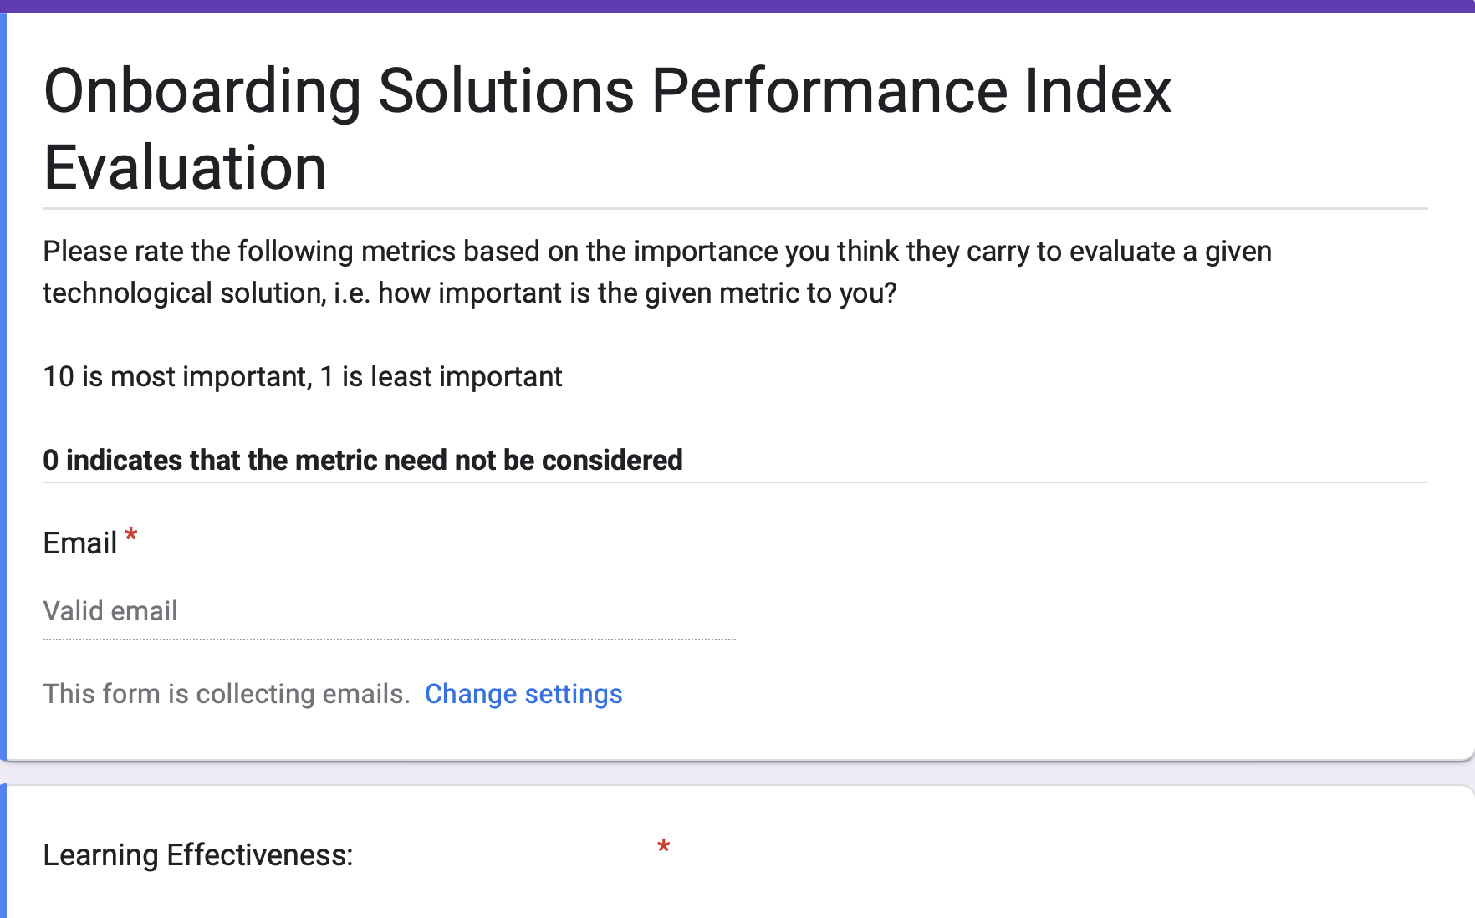
Evaluation Criteria
Learning Effectiveness: Ability to improve learning for new employees
Retention Effectiveness: Ability to improve information retention for new employees
Scalability: Scaling ability to accommodate Amazon Robotics' growing workforce
Customisability: Ability to customise technology to meet the specific needs of different roles and departments
Capital Investment (CapEx): Initial capital expenditure
Operations Expenditure (OpEx): Ongoing Operations costs
Ease of use: Simplicity of use for all
Security: Ability to protect Amazon Robotics' proprietary information
Access Control Security: Ability to implement role-based access control
Implementation Time: Expected time for implementing new solution
Multimodal Integration: Ability to assimilate different existing training information sources i.e. text-based, video-based etc
Safety: Safety hazards associated with technology for employees (if any)

Slide 29
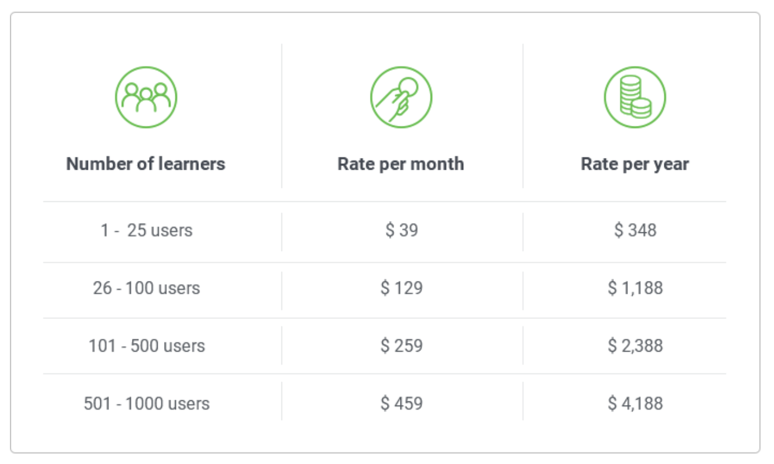
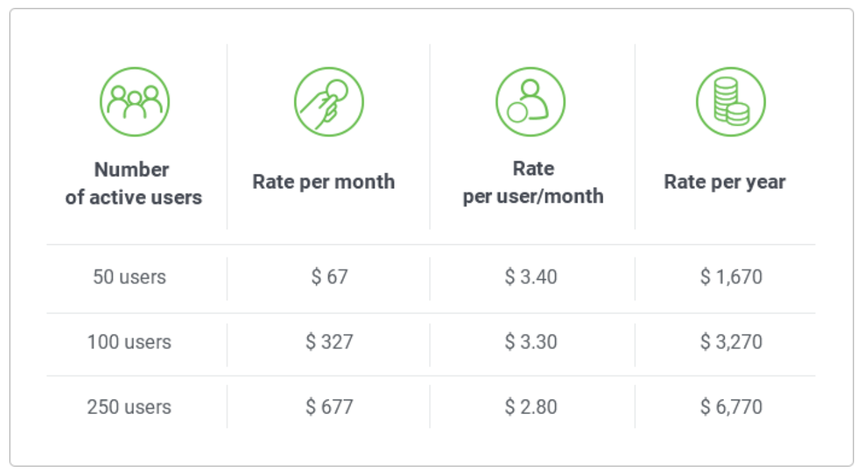
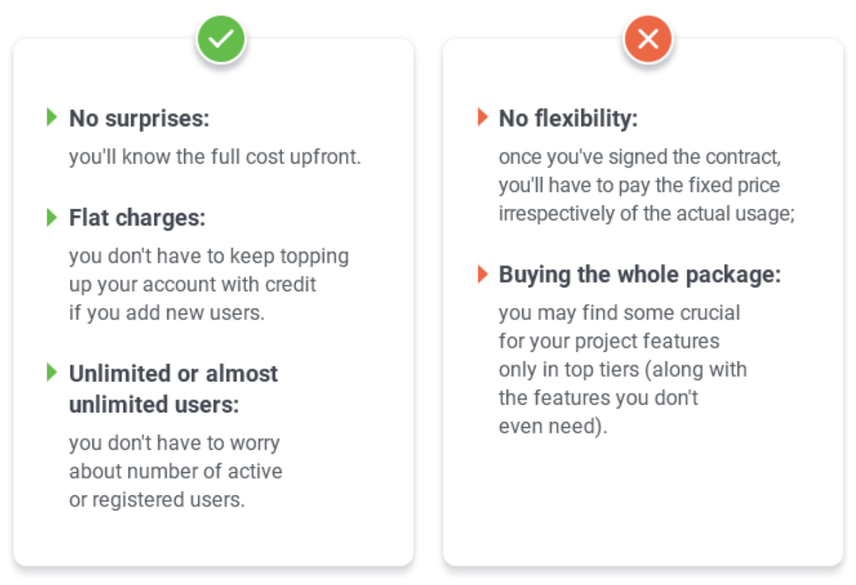
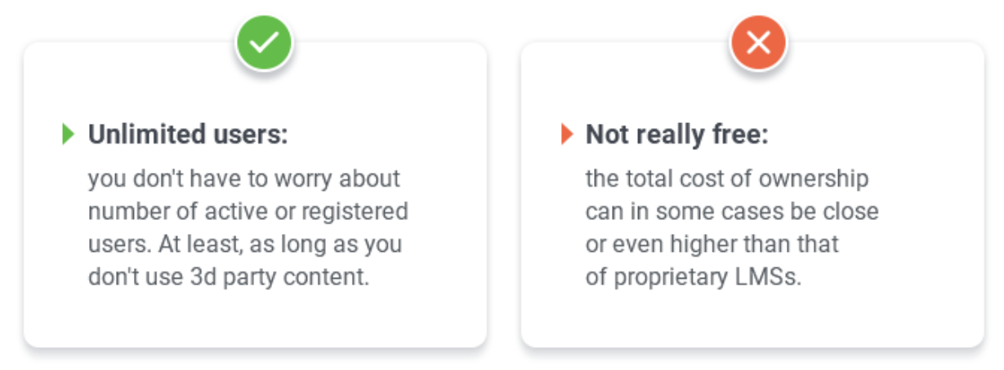
Appendix: LMS Pricing Models
Pay-per-Learner
Pay-Per-Active-Users
Licensing/Subscription
Open-Source

Slide 30
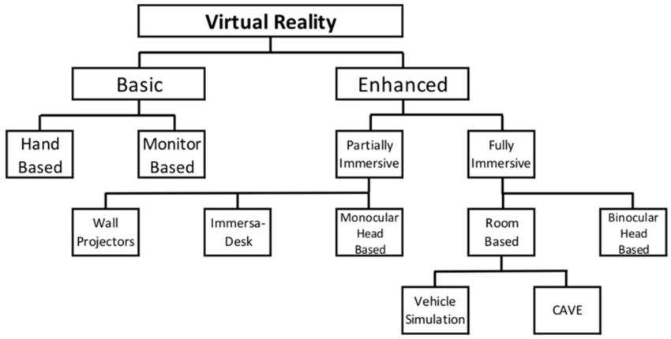
Appendix: VR Types
Notes:
https://www.researchgate.net/figure/Classification-of-virtual-reality-VR-based-on-type-of-technology-used-to-achieve_fig2_334451940

Slide 31
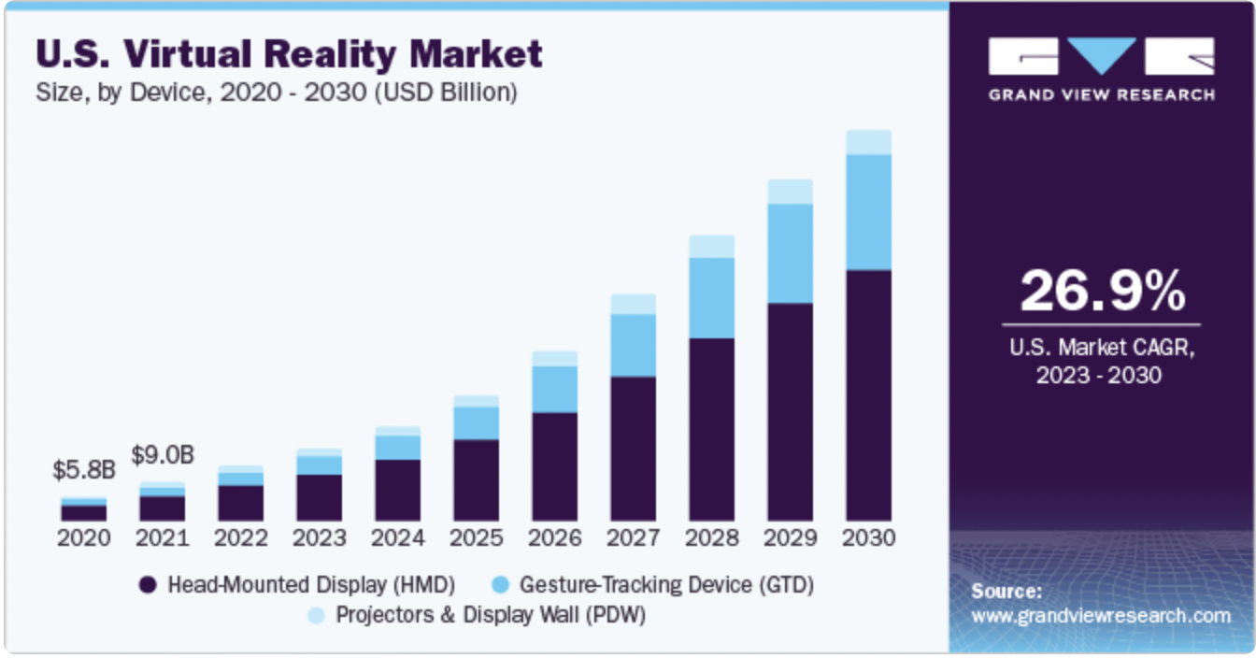
Appendix: VR Marketshare split
The global virtual reality (VR) market size was estimated at USD 59.96 billion in 2022
It is expected to grow at a compound annual growth rate (CAGR) of 27.5% from 2023 to 2030.
Notes:
Head Mounted Display (HMD) usually refers to a device with a small display such as projection technology integrated into eyeglasses or mounted on a helmet or hat. It's typically in the form of goggles or a headset, standalone or combined with a mobile phone (Gear VR).

Slide 32
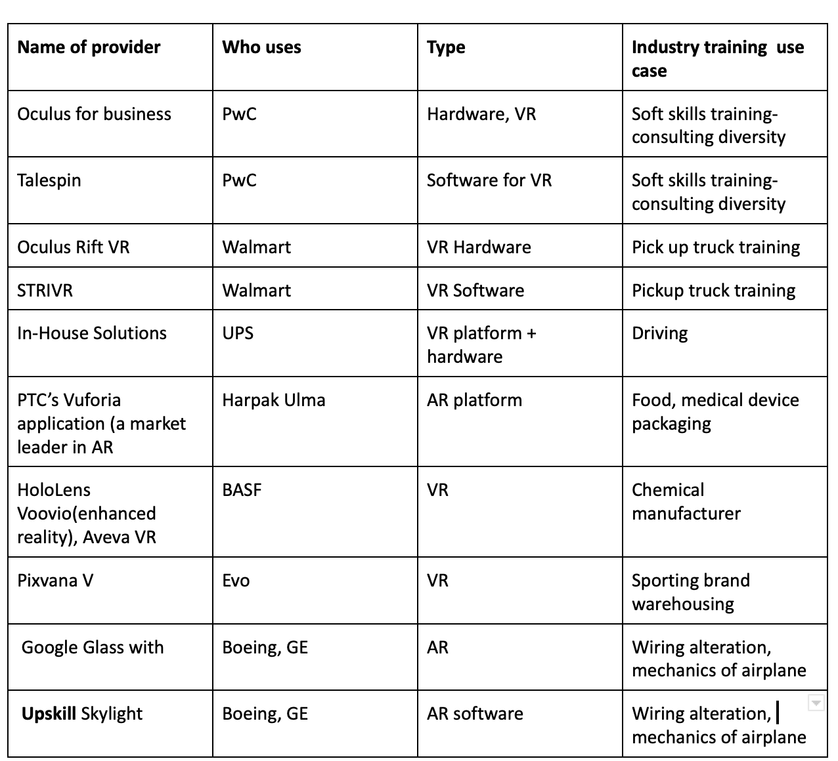
Appendix: XR Providers, Use Cases
Notes:
Head Mounted Display (HMD) usually refers to a device with a small display such as projection technology integrated into eyeglasses or mounted on a helmet or hat. It's typically in the form of goggles or a headset, standalone or combined with a mobile phone (Gear VR).

Slide 33
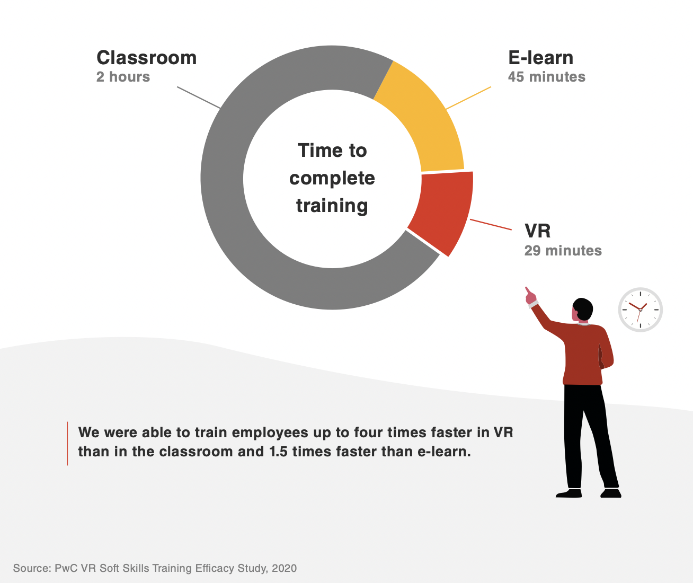
Appendix: Employees trained using XR completed training faster
Wiring production time reduced by 25% - Boeing
With VR, pickup tower training time has been reduced from 8 hours to approximately 15 minutes, and it has eliminated the need for launch coaches to travel to store sites. – Walmart
“We are starting to replace some global learning management system modules that can take 30 to 45 minutes and transitioning this to a three- to five-minute module in the virtual reality environment.- Walmart

Slide 34
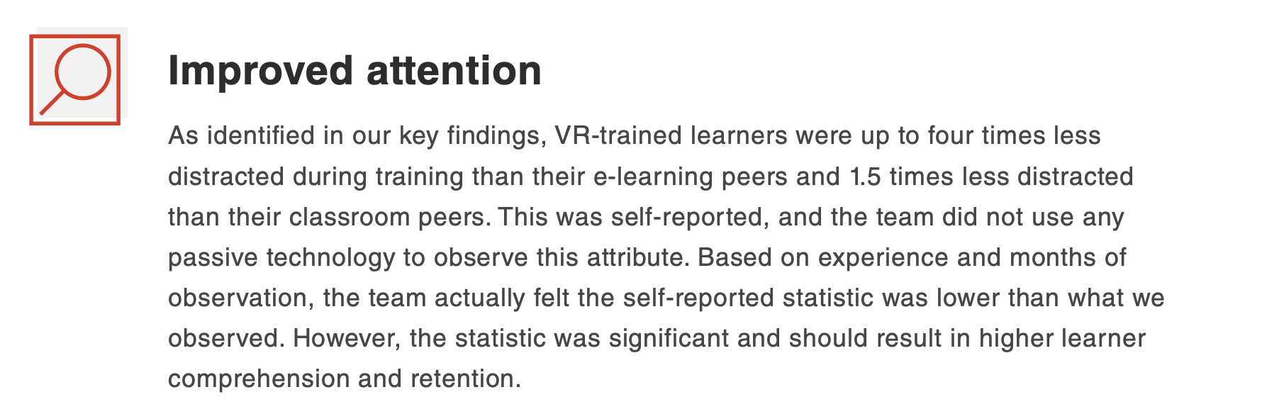
Appendix: XR enhances information retention
Boeing was able to reduce error rates to zero
"When we used the Oculus Rift VR headset in the classroom, we noticed an increase in test scores between 5 percent and 10 percent” - Walmart

Slide 35
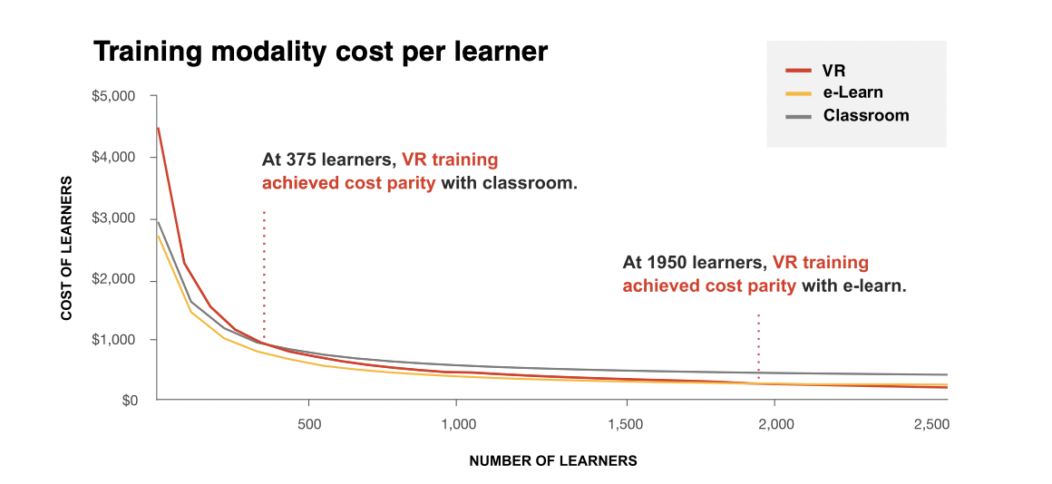
Appendix: XR Cost at Scale

Slide 36
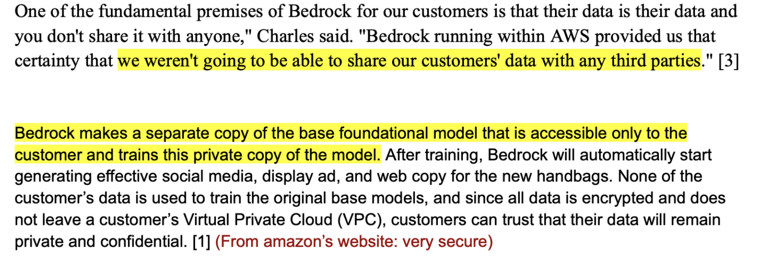
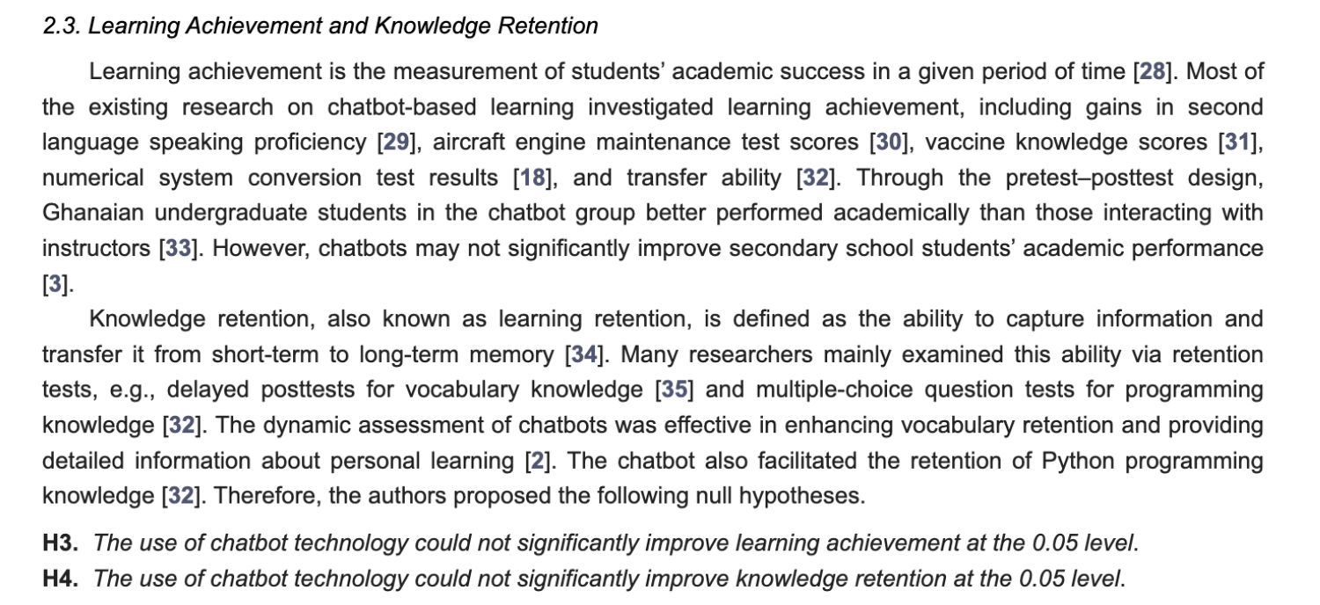
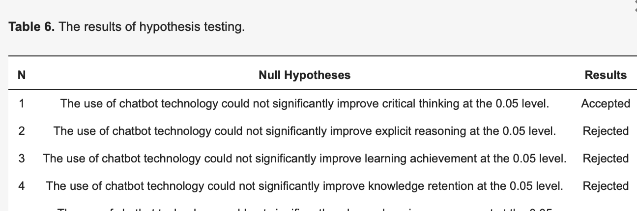
KPI LLM Evaluation
Data Security
Cost Analysis
Developer Costs: 15 hours base pay * 40 hours per week * 20 weeks * 2 developers = approx $25,000
Fine Tuning Costs: $0.0125 for 1000 tokens * 10M tokens in database (750,000 words approx) = approx $1.25 Million
Total: approximately 1.5 Million
Retention and Learning efficiency

Slide 37
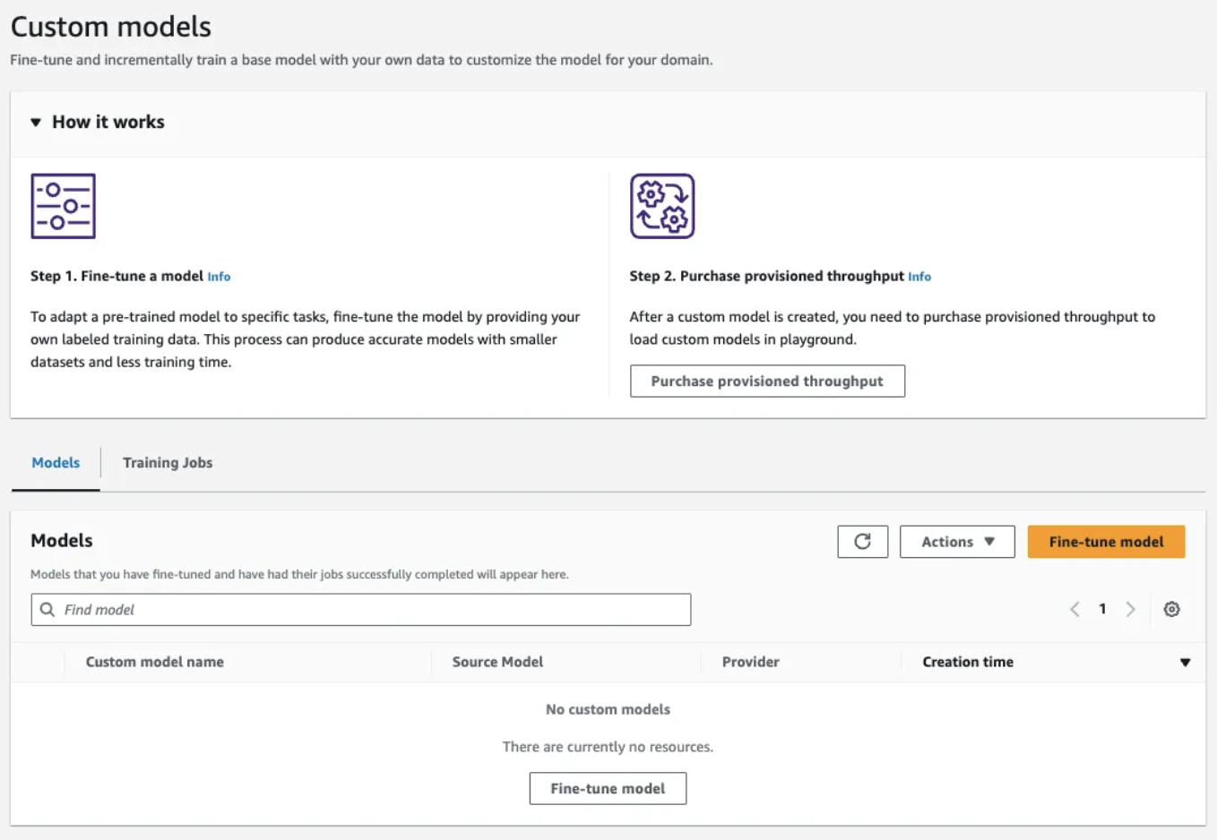
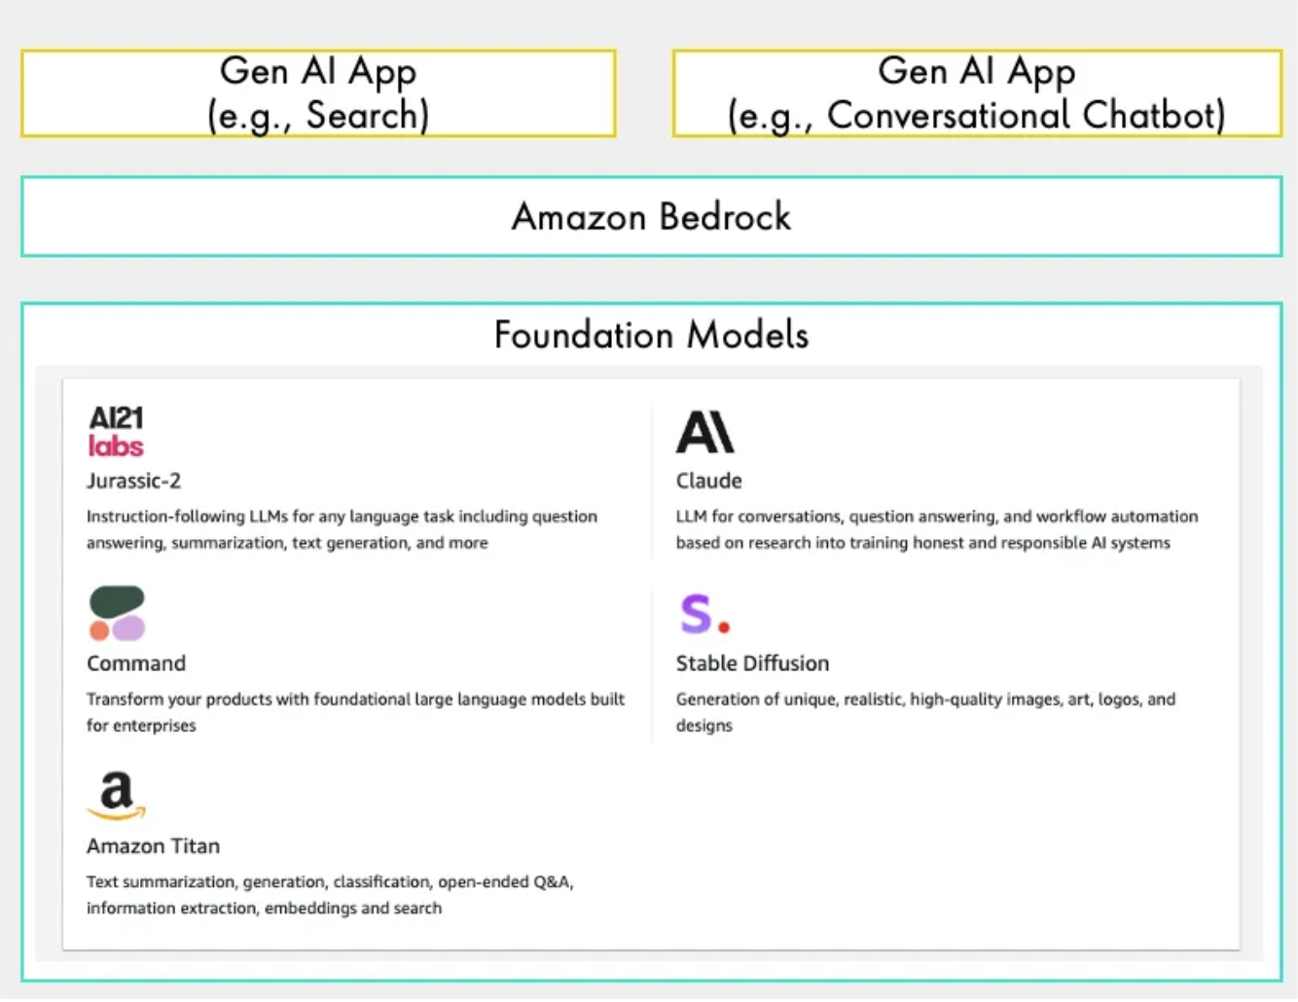
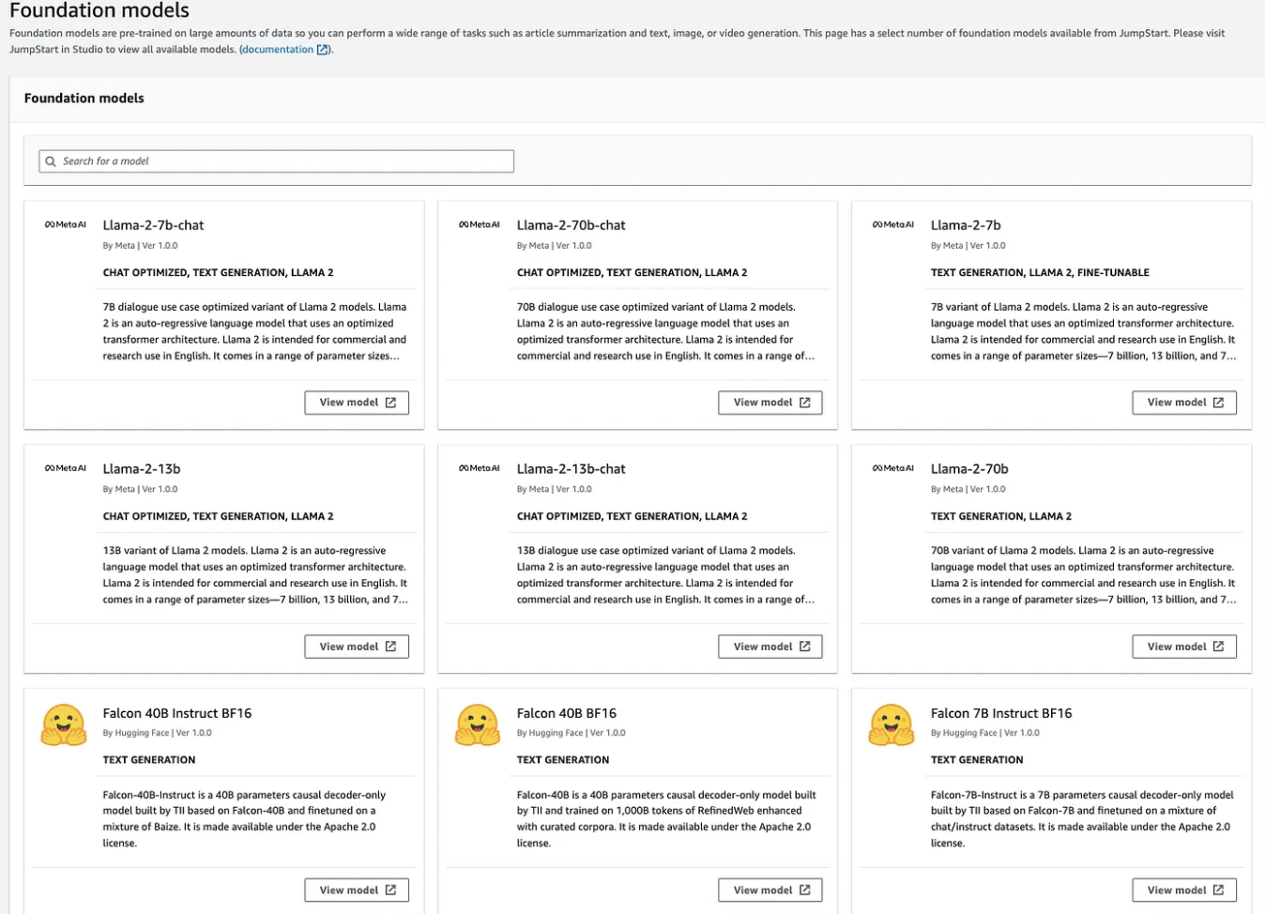
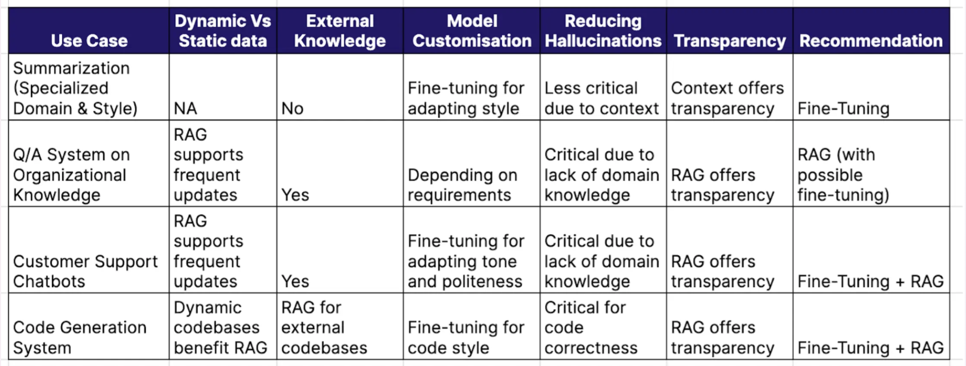
Key Players - LLM

